Slide 1


Slide 2

Introduction About Innovation Club
https://www.youtube.com/watch?v=A1VXU4Zk_u4&t=30s

Slide 3
Innovation Club
The Innovation Club has been set up in Government, Non-Government, Grantee In Aid Colleges and Gram Vidhyapith, all over the State of Gujarat with the noble intention that even non-technical students, (studying in Arts, Commerce and Science Colleges) under which plentiful number of students will be encouraged for creative ideas and will be prepared for startups.
Innovation club is a concept to inspire and indulge non technical students to work on their ideas and convert them into startups. Innovation club is based on STEM pedagogy.
With help of innovation club students can generate their ideas and convert this ideas into real life products with tools provided by innovation club.

Slide 4

Advance Electronics

Slide 5
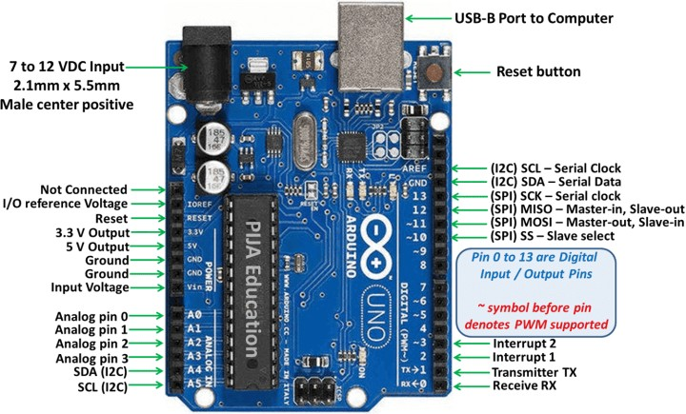

Arduino Uno Board

Slide 6
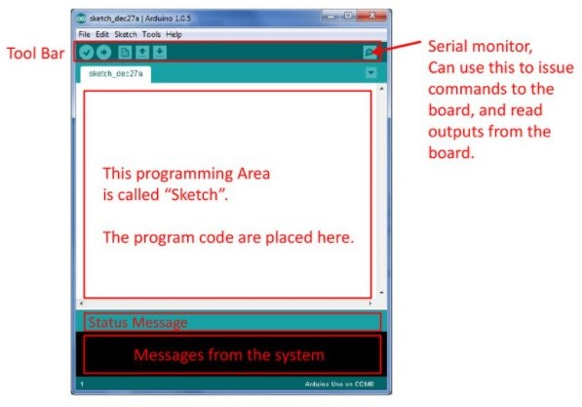

Arduino IDE

Slide 7
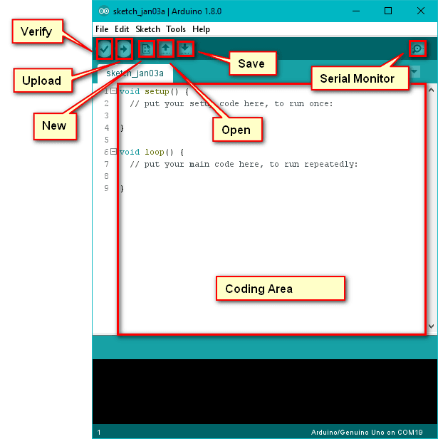
Toolbar of Arduino IDE

Slide 8
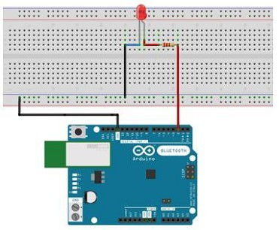
Activity 01: LED Blink
Components
  Arduino Uno Board
  LED
  Resistor
  Jumper wires
  Breadboard

Slide 9
Arduino IDE Code
// the setup function runs once when you press reset or power the board
void setup() {
// initialize digital pin LED_BUILTIN as an output.
pinMode(LED_BUILTIN, OUTPUT);
}
// the loop function runs over and over again forever
void loop() {
digitalWrite(LED_BUILTIN, HIGH); // turn the LED on (HIGH is the voltage level)
delay(1000); // wait for a second
digitalWrite(LED_BUILTIN, LOW); // turn the LED off by making the voltage LOW
delay(1000); // wait for a second
}

Slide 10
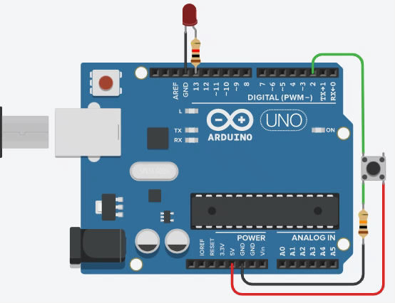
Activity 02: Push button
Components
  Arduino Uno Board
  LED
  Resistor
  Push button
  Jumper wires
  Breadboard

Slide 11
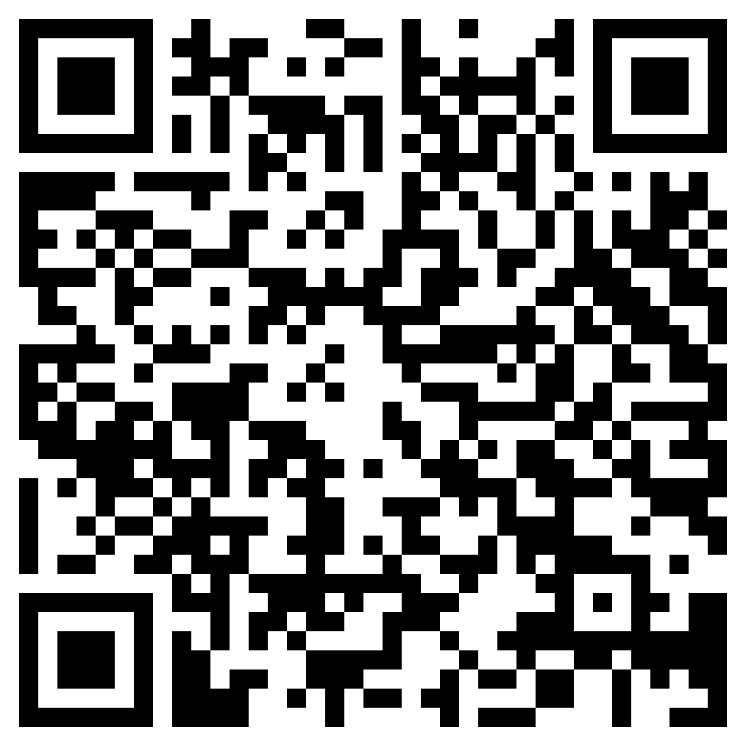
QR Code
https://github.com/Shriji-technoaspire/Arduino-projects/blob/main/PUSH_BUTTON_LED.ino

Slide 12
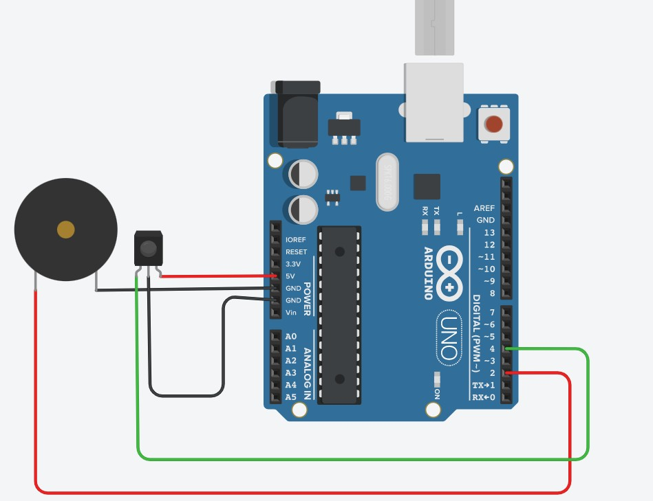
Activity 03: Object detection alarm
Components
  Arduino Uno Board
  Buzzer
  IR sensor
  Jumper wires
  Breadboard

Slide 13
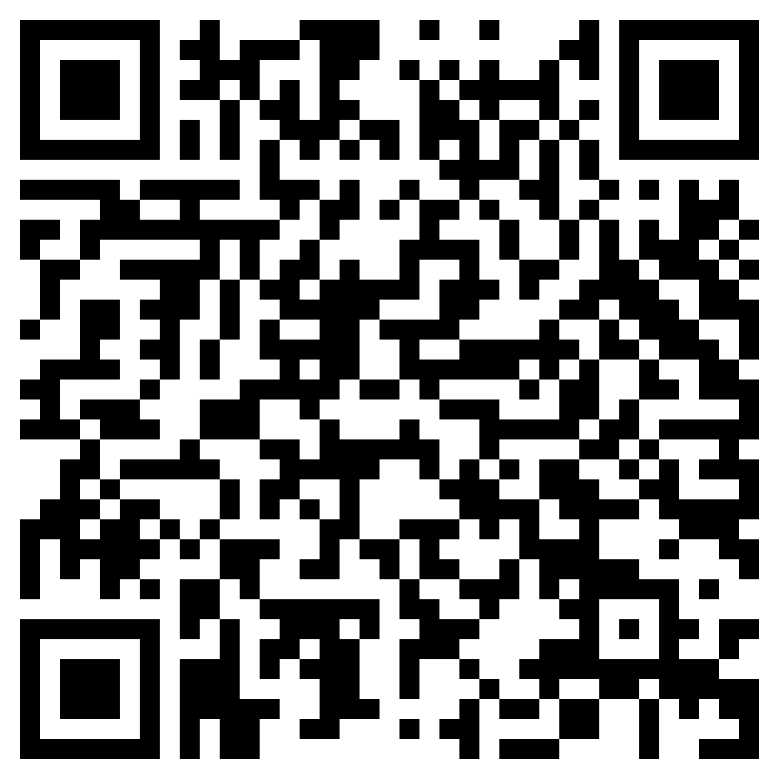
QR Code
https://github.com/Shriji-technoaspire/Arduino-projects/blob/main/IR_SENSOR_WITH_BUZZER.ino

Slide 14
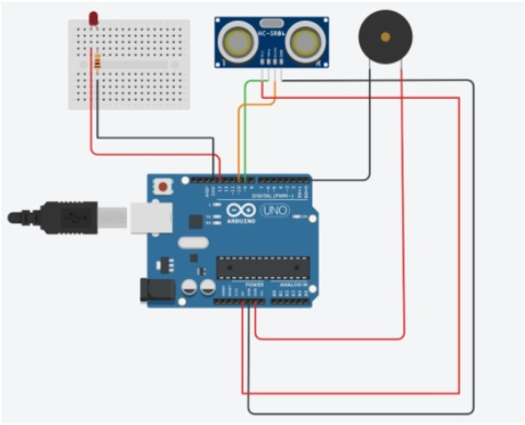
Activity 04: Social Distancing
Components
  Arduino Uno Board
  Buzzer
  Led and resistor
  Ultrasonic Sensor
  Jumper wires
  Breadboard

Slide 15
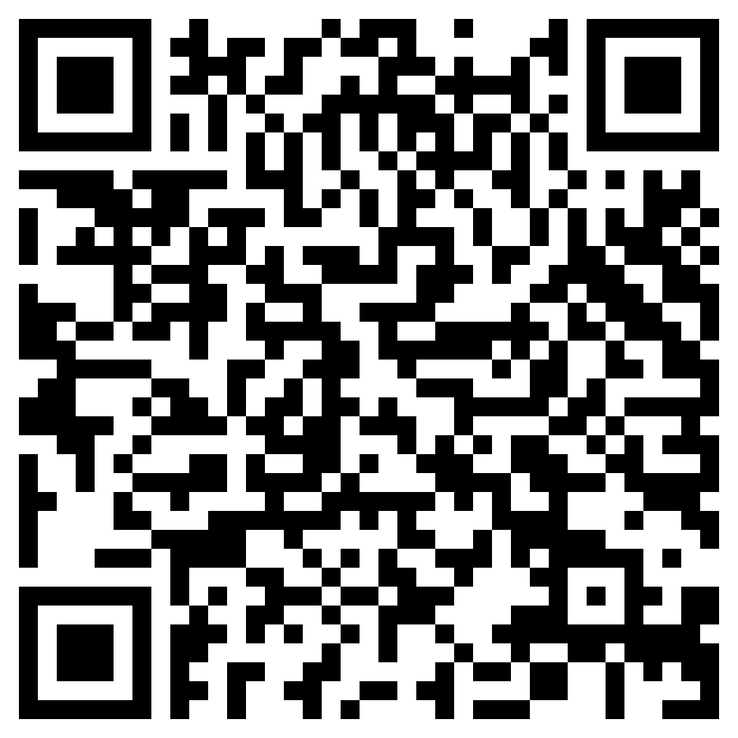
QR Code
https://github.com/Shriji-technoaspire/Arduino-projects/blob/main/Social_distance_project.ino

Slide 16
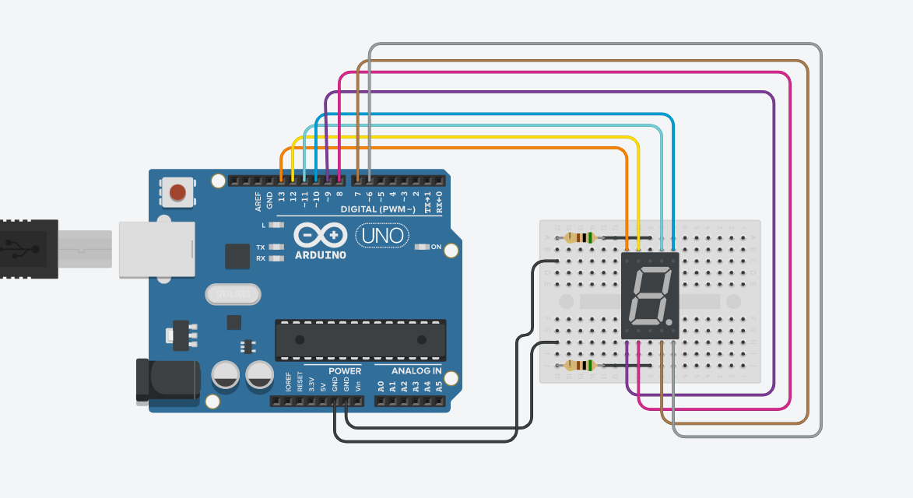
Activity 05: 7 segment LED
Components
  Arduino Uno Board
  7 Segment LED
  Jumper wires
  Breadboard

Slide 17
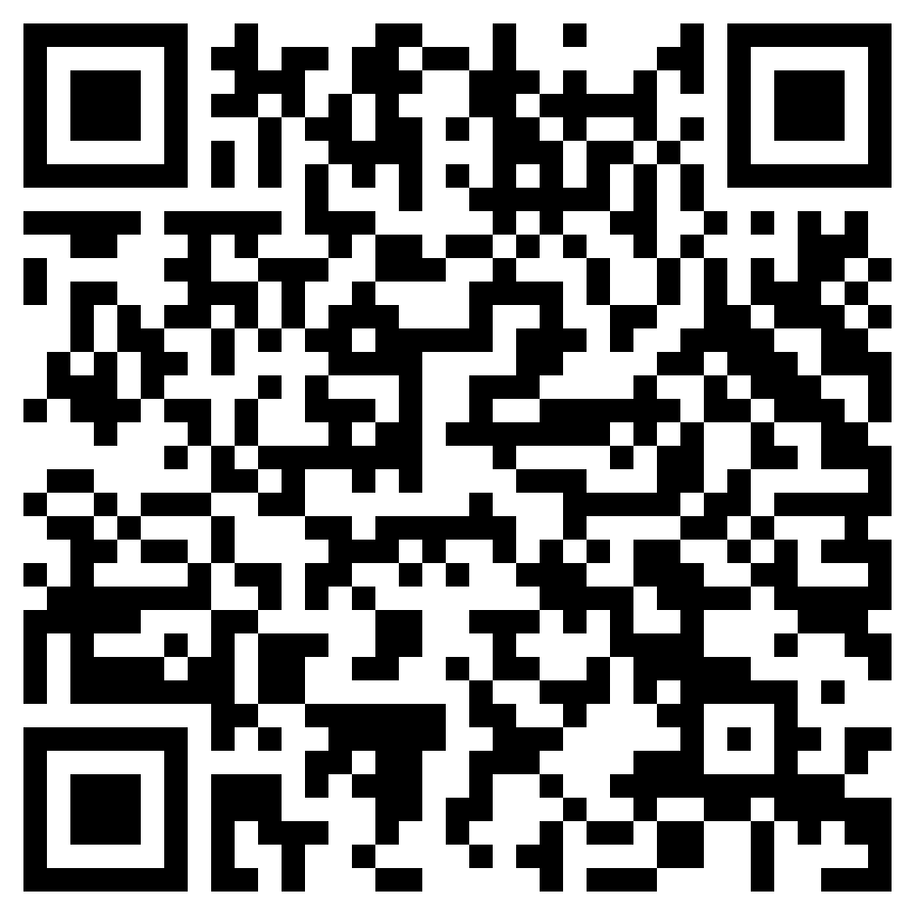
QR Code
https://github.com/Shriji-technoaspire/Arduino-projects/blob/main/7_SEGMENT_ARUINO_CODE.ino

Slide 18
Telescope

Slide 19
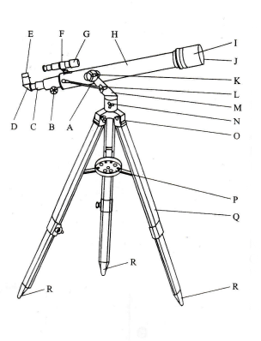
Micro adjustable Altitude control
Focusing wheel
Focusing tube
Angle prism
Eyepiece
Finder scope bracket
Finder scope
Main telescope body
Sunshade
Lens
Yoke locking screw
Adjustment locking nut
Yoke bracket
Azimuth lock
Tripod head
Accessory tray
Tripod leg
Rubber tipped feet
Telescopes Parts

Slide 20
YouTube link for assemble the Telescope
https://youtu.be/12ChRvCMXW8

Slide 22
How do Telescopes Work?
Telescopes have two main parts:
the first lens (objective lens )
the second lens (the eyepiece)
Telescopes that use only lenses are called refracting telescopes / refractors. [ F70060 ]
Some telescopes use a mirror, called the primary mirror, in place of the first lens. These are called reflecting telescopes/reflectors.

Slide 23
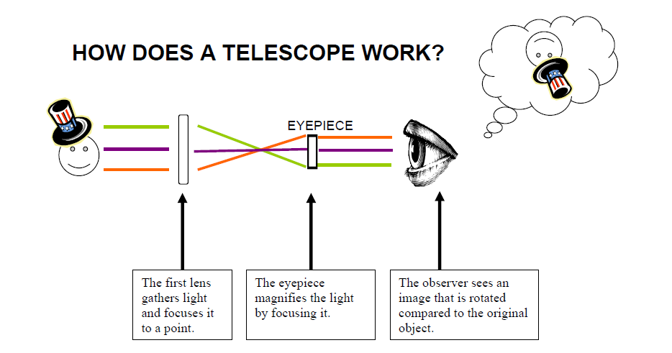

Slide 24
Telescope Power/Magnification
Eyepiece | Magnification Power | Magnification Power With a 1.5x Eyepiece extension | Power with a 3x Barlow lens
SR4mm | 175x | 263x | 525x
H12.5mm | 56x | 84x | 168x
H20mm | 35x | 53x | 105x

Slide 25
Which magnification should be chosen?
The magnification defines the telescope’s ability to enlarge an image or to bring it closer in order to see it better.
$$Example: \frac{700mm focal length}{eyepiece focal length 12.5mm}=56x magnification$$
𝐸𝑥𝑎𝑚𝑝𝑙𝑒: (700𝑚𝑚 𝑓𝑜𝑐𝑎𝑙 𝑙𝑒𝑛𝑔𝑡ℎ)/(𝑒𝑦𝑒𝑝𝑖𝑒𝑐𝑒 𝑓𝑜𝑐𝑎𝑙 𝑙𝑒𝑛𝑔𝑡ℎ 12.5𝑚𝑚)=56𝑥 𝑚𝑎𝑔𝑛𝑖𝑓𝑖𝑐𝑎𝑡𝑖𝑜𝑛

Slide 26
Drone

Slide 27
Video Link for Drone Remote Control
https://youtu.be/Vd5jeqW3As4

Slide 28
Introduction to UAV
Drones also known as UAV is an abbreviation of Unmanned Aerial Vehicle, meaning aerial vehicles which operate without a human pilot on board.
UAVs are commonly used in both the military and police forces in situations where the risk of sending a human piloted aircraft is unacceptable, or the situation makes using a manned aircraft impractical.

Slide 29
Classification of Drone
Fixed wing Drone
Single Rotary wing Drone
Multi rotor Drones
Tactical Drones
Micro Drones
Racing Drones
Photography Drones

Slide 30
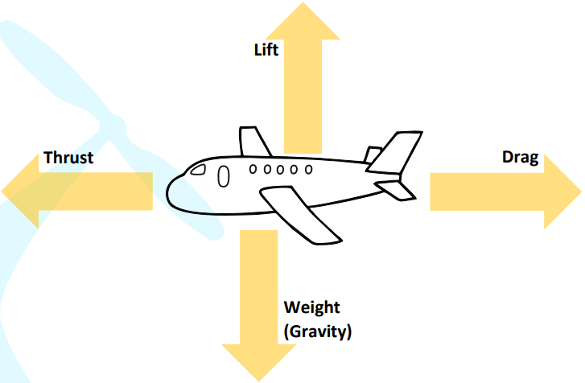
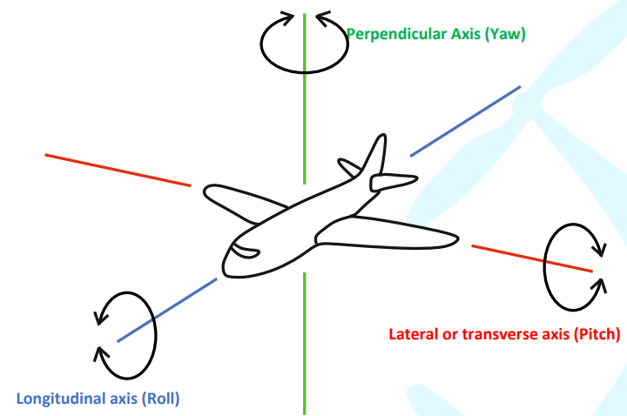
Dynamics of an aerial system

Slide 31
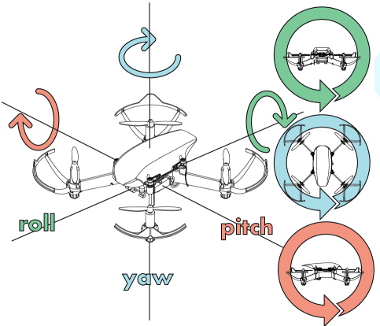
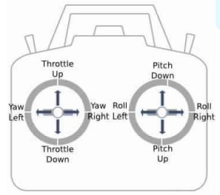
CONTROL OF DRONE

Slide 32
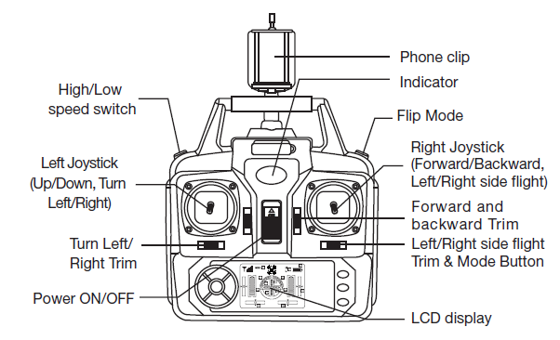
Drone Remote control

Slide 33
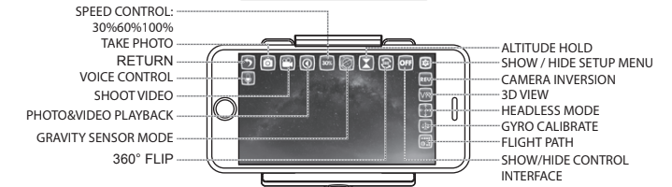
Mobile Application App (GX-FPV)

Slide 34
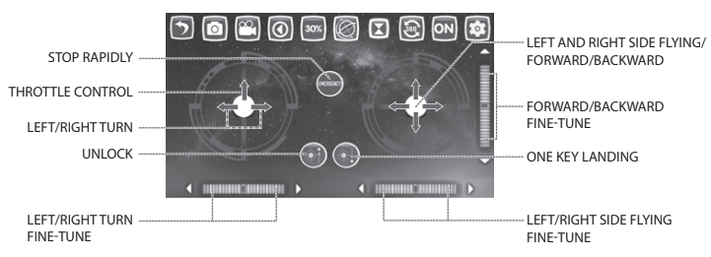
GX-FPV Mobile Control

Slide 35
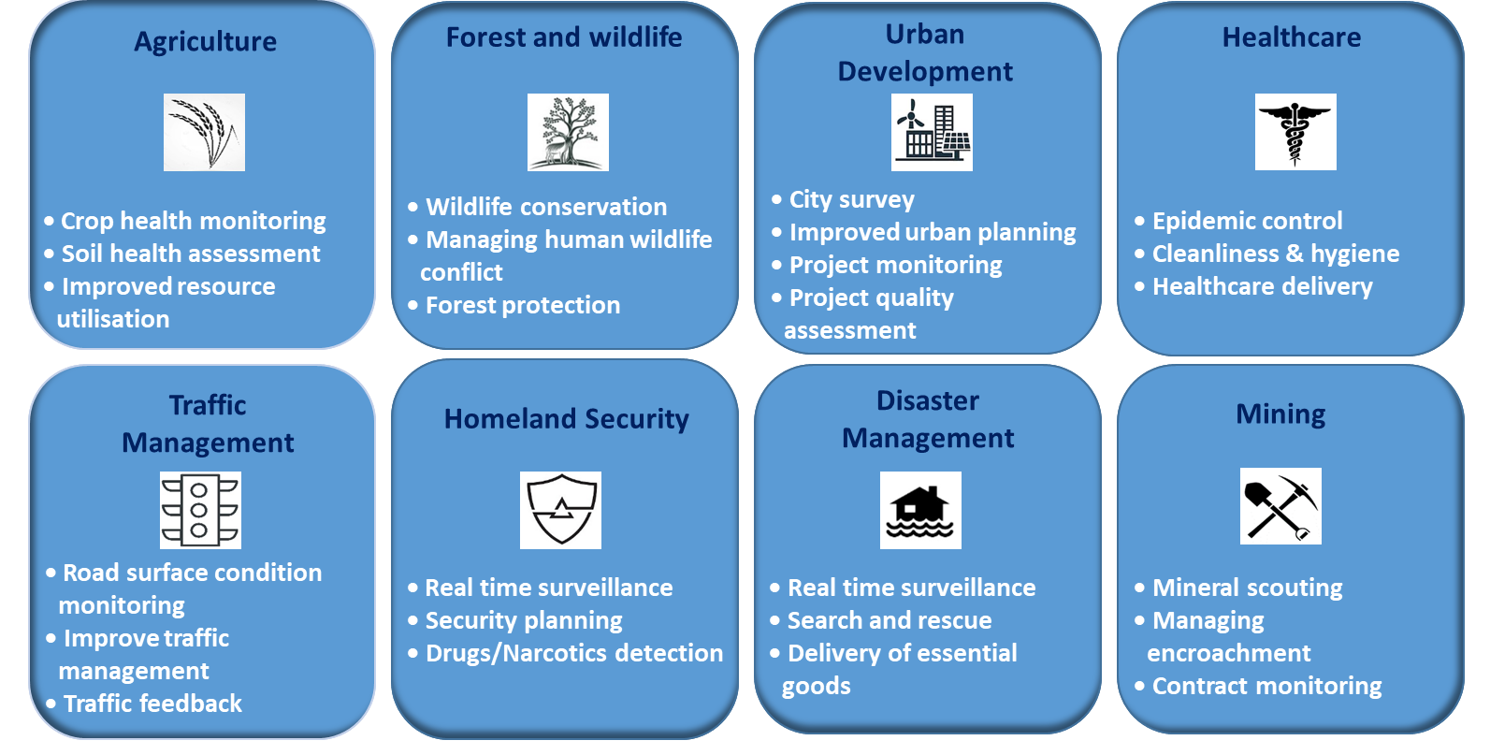
Application of drone

Slide 36
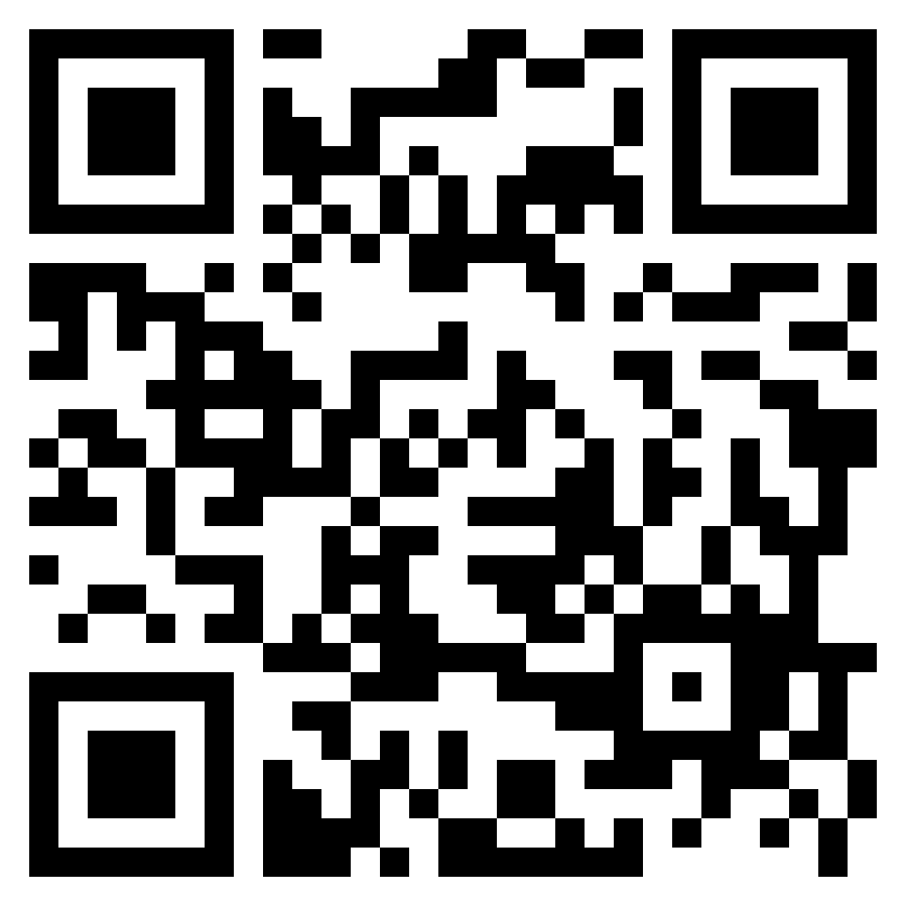
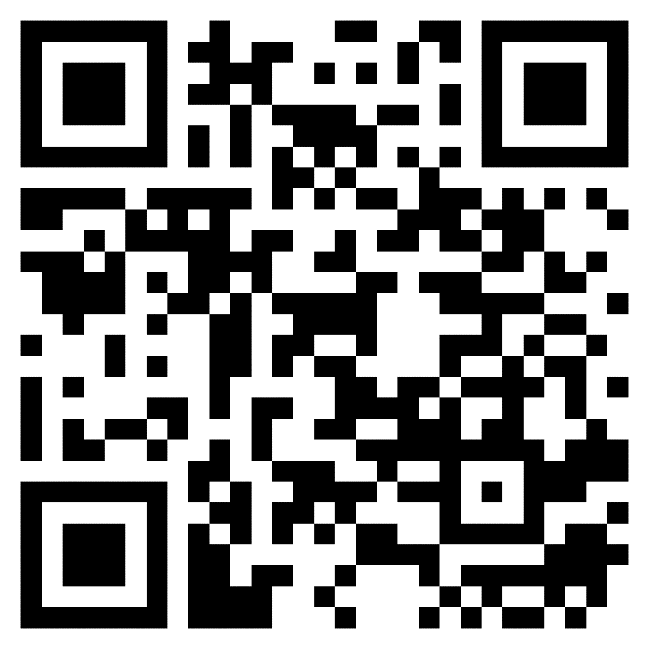

QR Codes
Quiz form
Feedback form

Slide 37


Social Media QR Code

Slide 38
THANK YOU

